Slide 1

Improving Text Extraction Accuracy with Image Preprocessing
Under the guidance of Dr. T. Sridevi
BE2102-07
1601 18 733 067
1601 18 733 081

Slide 2
Agenda
Introduction
Literature Survey
Proposed Solution
Architecture
References

Slide 3
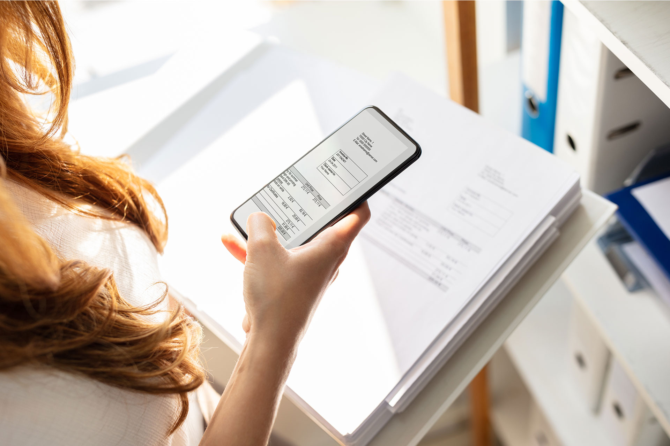
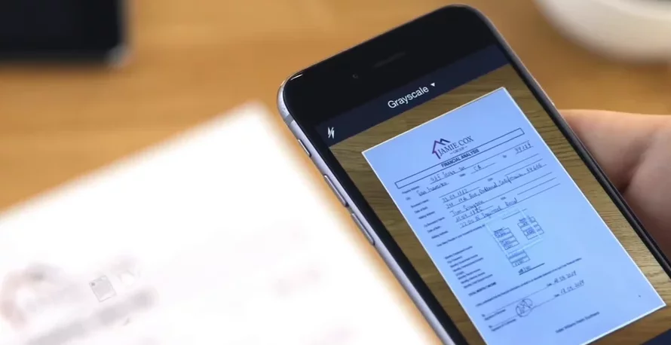
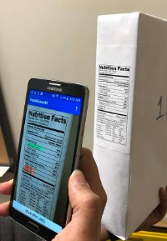
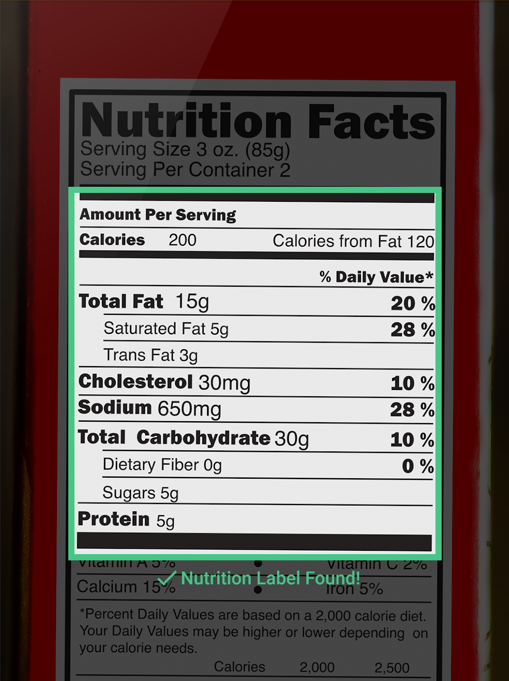

Slide 4
Literature Review

Slide 5
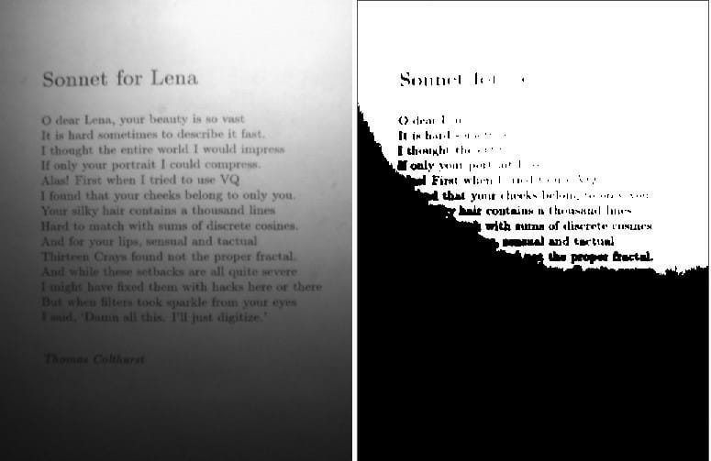
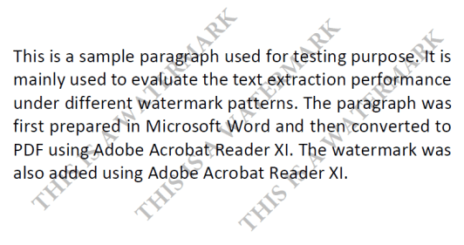
Yang Zhang and Hao Zhang HaoranLi [1] described in their paper, an information extraction pipeline used for event flyers. The paper lists several situations where a raw image could cause inaccurate results.
The image preprocessing methods included were edge detection, geometric correction(transformation), and Binarization.
Rishabh Mittal and Anchal Garg [2] introduced and explained the concept of OCR and the process of extraction.
The paper reveals that the modern ocr system’s preprocessing pipeline is restricted to spatial image filtering, thresholding, noise-removal and skew detection/correction.

Slide 6
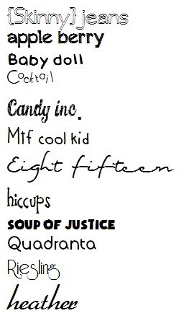

Sanjeev Kumar, Mahika Sharma, Kritika Handa, Rishika Jaiswal [3] proposed an algorithm to improve ocr accuracy with advanced image preprocessing using machine learning.
Their focus was to reduce the noise of the image which has helped to eliminate biggest obstacle of the Tesseract - computation time of reading images with the highest character dimensions above 20 pixels.
Dan Sporici, Elena Cușnir and Costin-Anton Boiangiu [4] underlined Tesseract 4.0 flaws, highly related to the segmentation procedure and proposed an adaptive image preprocessing step guided by a reinforcement learning model.
The algorithm can get stuck on kernel configurations which will provide inferior results if not enough exploration is performed.

Slide 7
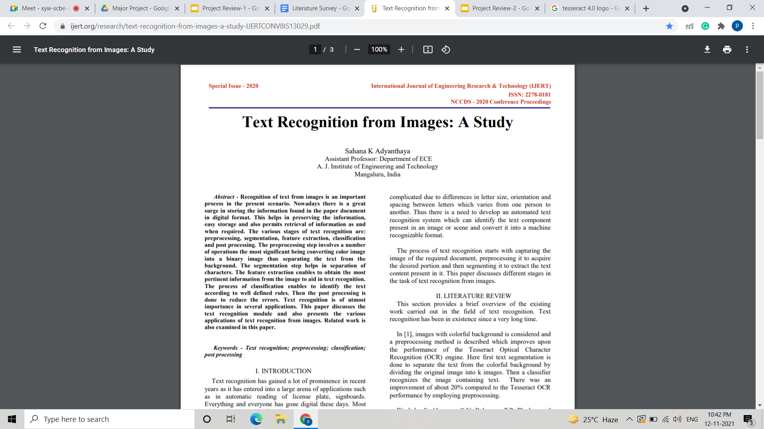
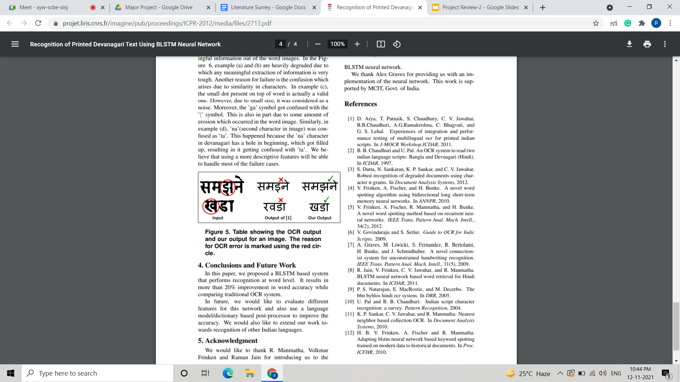
Sahana K Adyanthaya put forward a paper [5] that presents the various steps taken to recognise text from images and highlights that the noise present in an image has a major role to play in successful text recognition.
It also mentions that Gaussian filter and mean filter can be used for noise removal, normalization should be done to ensure uniformity followed by binarization to convert the gray image into a binary image.
Naveen Sankaran and C.V Jawahar [6] proposed a neural network-based framework that operates based on BLSTM-Bidirectional Long Short-Term Memory that allows OCR to work at the word level.
It uses a method that does not require segmentation, that is one amongst the foremost common reasons for the error.

Slide 8
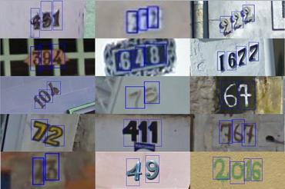
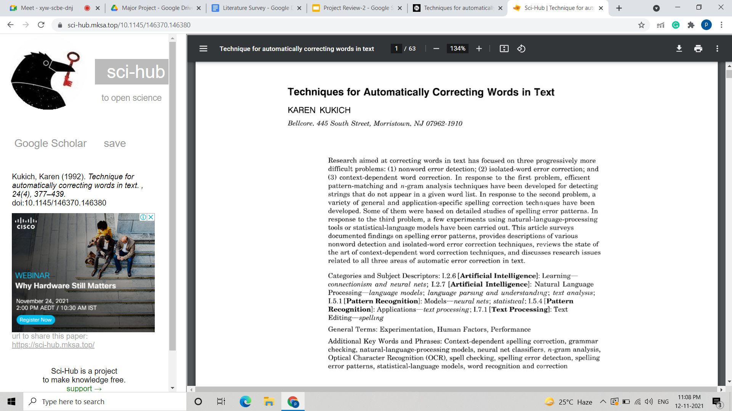
Sai Abhishikth Ayyadevara, P N V Sai Ram Teja, Rajesh Kumar M [7], deals with two different machine learning techniques.
The second includes the analysis of the performance of different neural networks for geometric and gradient feature technique.
They concluded that CNN is most efficiently absorbed through the Levenberg-Marquardt algorithm.
Kukich[1] suggested using a n-gram dictionary or method based on the errors and returning the possible word to the dictionary using mathematical steps.
These methods may reduce the total number of OCR errors in standard language names, but it is possible that the words may be correctly identified that are not in the dictionary of geographical names.

Slide 9
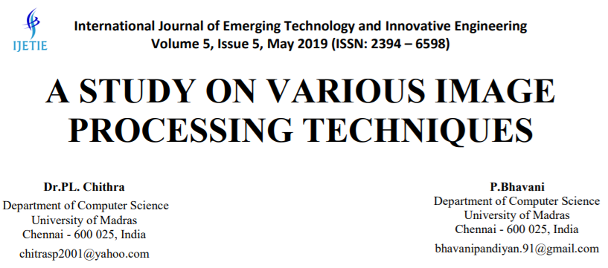
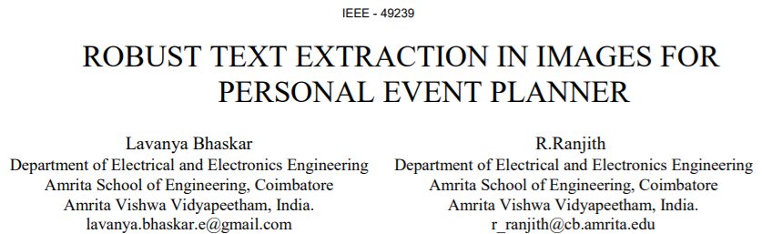
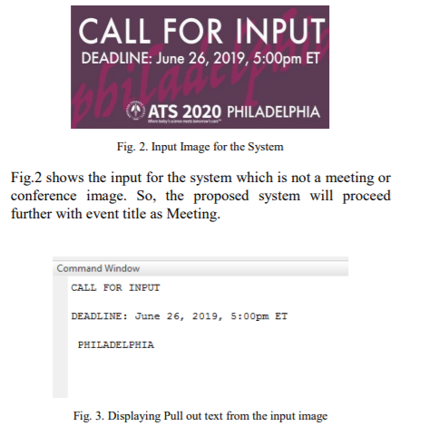
Dr. PL Chitra, and P Bhavani [9], in this paper have studied various images to remove unwanted noise and performed enhancement techniques
Techniques such as contrast limited adaptive histogram equalization, Laplacian and Harr filtering, unsharp masking, sharpening, high boost filtering and color models were used to preprocess the images.
Lavanya Bhaskar and R Ranjit [10] discuss an event planner for the brochure images, that implements text extraction by convolution followed by MSER feature extraction and Stroke width method.
The event planner then directly links the event text to the google calendar for scheduling the events.

Slide 10
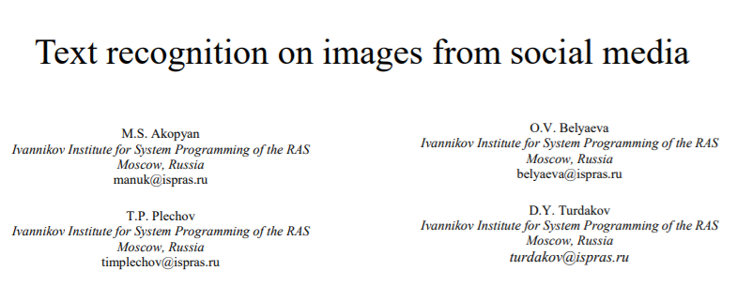
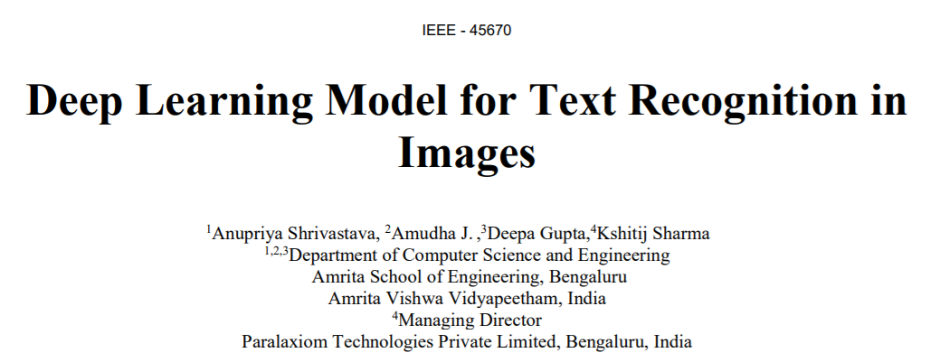
Work by M.S. Akopyan, O.V. Belyaeva, T.P. Plechov and D.Y. Turdakov [11] is based on a text extraction pipeline which is used to extract text from varied quality of images obtained from social media
Their work focused on dividing and preprocessing the input images based on various classes, followed by text recognition using the OCR engine.
Anupriya Shrivastava, Amudha J.Deepa Gupta and Kshitij Sharma [12] in their work have developed a system based on Convolutional Neural Network and Long Short Term Memory.
The developed model identifies the texts from images which are horizontal, curved or oriented style.

Slide 11
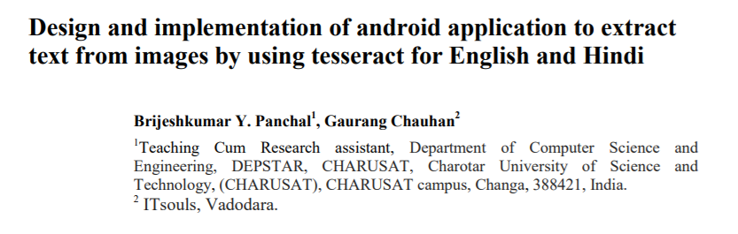
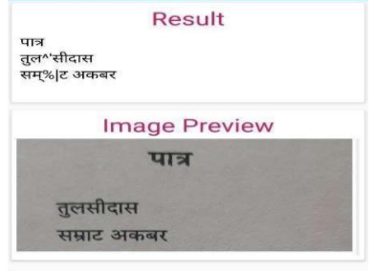
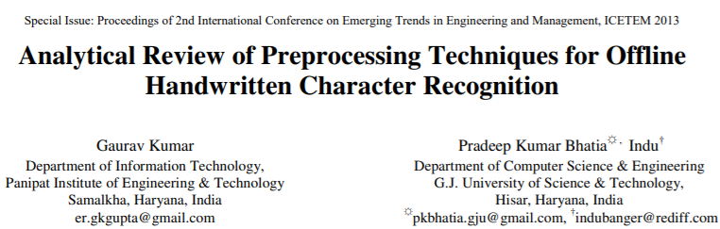
Brijesh Kumar Y. Panchal, and Gaurang Chauhan [13] proposed an implementation through an Android Application to extract using Tesseract OCR. Using this Optical Character Recognition (OCR) Technology.
The Application generates text which is printed on a clean, B/W or colourful background and then can be converted into a computer readable form ASCII.
K. Gaurav, Bhatia P. K. [14], deals with assorted pre-processing techniques used for handwritten recognition which consists of different images starting from a simple handwritten document to complex background and diverse image intensities.
They concluded that a single preprocessing technique can’t be used to produce an image for accurate results.

Slide 12
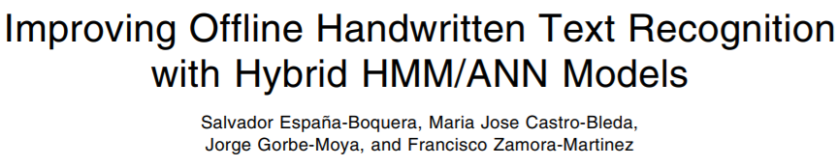
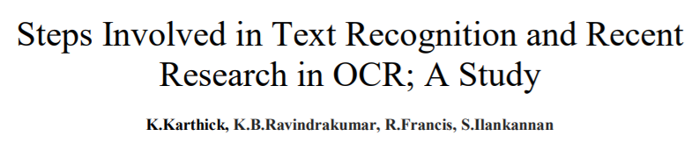
Salvador España-Boquera, Maria J. C. B., Jorge G. M. and Francisco Z. M. [15] outlines the hybrid Hidden Markov Model (HMM) is used to conceive the unconstrained offline handwritten texts.
The main characteristics of the recognition systems is to produce a new way in the form of preprocessing and recognition which are both based on ANNs.
K. Karthick, K.B. Ravindrakumar, R. Francis and S.Ilankannan [16] have discussed the various steps and techniques used for text detection.
From their study it has been found that best results can be had with reduced computation time and it is possible to segment multilingual characters and enhance the character recognition rate.

Slide 13
Solution

Slide 14








Document
Scan
Scanned Image File Upload
Text Document
Image Preprocessing Pipeline
OCR
Notes:
Preprocessing pipeline workflow
Speech to text

Slide 15


Scanned Image File Upload
Image Preprocessing Pipeline
Optical Character Recognition
Text Extraction
Information Extraction
Text - to - Speech Conversion
Document
Scan
API Deployment
Notes:
Preprocessing pipeline workflow
Speech to text

Slide 16
Architecture

Slide 17
Hardware Requirements
Software Requirements
32-or-64 bit operating system.
Single/Multi Core + 1GHz and above microprocessor.
RAM: 4GB and above.
Hard-drive space: 60MB or higher.
Internet Connection: 4Mbps or higher.
Operating system: Windows.
Software tool: Tesseract.
Python version 3 or above.
OpenCV
Pillow
NLTK
Notes:
Preprocessing pipeline workflow
Speech to text

Slide 18
References
[1] K. Karthick, K.B. Ravindrakumar, R. Francis, S. Ilankannan, “Steps Involved in Text Recognition and Recent Research in OCR; A Study”, International Journal of Recent Technology and Engineering (IJRTE) ISSN: 2277-3878, Volume-8, Issue-1, May 2019.
[2] Mittal, Rishabh; Garg, Anchal, “Text extraction using OCR: A Systematic Review”, 2020 Second International Conference on Inventive Research in Computing Applications (ICIRCA), 2020, pp 357–362.
[3] Sanjeev Kumar, Mahika Sharma, Kritika Handa, Rishika Jaiswal, “Improve OCR Accuracy with Advanced Image Preprocessing using Machine Learning with Python”, International Journal of Innovative Technology and Exploring Engineering (IJITEE) ISSN: 2278-3075, Volume-9 Issue-7, May 2020.
[4] Dan Sporici, Elena Cușnir and Costin-Anton Boiangiu, “Improving the Accuracy of Tesseract 4.0 OCR Engine Using Convolution-Based Preprocessing”, International Journal of Innovative Technology and Exploring Engineering, Volume-12 Issue-5, May 2, 2020.

Slide 19
References
[5] Sahana K Adyanthaya, “Text Recognition from Images: A Study”, International Journal of Engineering Research & Technology (IJERT), ISSN: 2278-0181, Volume-8 Issue-13, 2020.
[6] Naveen Sankaran and C.V Jawahar, “Recognition of Printed Devanagari Text Using BLSTM Neural Network”, 21st International Conference on Pattern Recognition (ICPR), November 11-15, 2012. Tsukuba, Japan.
[7] Sai Abhishikth Ayyadevara, P N V Sai Ram Teja, Bharath K P Rajesh Kumar M, “Handwritten Character Recognition Using Unique Feature Extraction Technique”, International Research Journal of Modernization in Engineering Technology and Science, Volume-3 Issue-10, Jan 2020.
[8] Karen Kukich, “System that automatically converts word into text”, ACM Computing Surveys, Vol. 24, No. 4, December 1992.

Slide 20
References
[9] Dr. PL Chithra, P Bhavani, P. , “A Study on Various Image Processing Techniques”, International Journal of Emerging Technology and Innovative Engineering (ISSN (print): 2394 – 6598) Volume 5, Issue 5, May 2019.
[10] Bhaskar, L., & Ranjith, R. , “Robust Text Extraction in Images for Personal Event Planner”,. 2020 11th International Conference on Computing, Communication and Networking Technologies (ICCCNT) July 1-3, 2020, IIT-Kharagpur, Kharagpur, India.
[11] M.S. Akopyan, O.V. Belyaeva, T.P. Plechov and D.Y. Turdakov, “Text recognition on images from social media”, Ivannikov Memorial Workshop (IVMEM), 2019.
[12] Anupriya Shrivastava, Amudha J., Deepa Gupta, Kshitij Sharma, “Deep Learning Model for Text Recognition in Images”, 10th ICCCNT 2019 July 6-8, 2019, IIT - Kanpur, Kanpur, India.

Slide 21
References
[13] Brijeshkumar Y. Panchal and Gaurang Chauhan, “Design and implementation of android application to extract text from images by using tesseract for English and Hindi”, 3rd International Scientific Conference of Engineering Sciences and Advances Technologies (IICESAT), Journal of Physics: Conference Series, Volume 1973, 4-5 June, 2021.
[14] K. Gaurav and Bhatia P. K., “Analytical Review of Preprocessing Techniques for Offline Handwritten Character Recognition”, 2nd International Conference on Emerging Trends in Engineering & Management, ICETEM, 2013.
[15] Salvador España-Boquera, Maria J. C. B., Jorge G. M. and Francisco Z. M., “Improving Offline Handwritten Text Recognition with Hybrid HMM/ANN Models”, IEEE Transactions on Pattern Analysis and Machine Intelligence, Vol. 33, No. 4, April 2011.
[16] Yang Zhang, Hao Zhang, HaoranLi, “Event Info Extraction from Flyers”, 2021.

Slide 22
Thank you

